Slide 1
Predicting Elevated Cancer Rates Near Washington State Industrial Facilities
Nick Carroll, Arpita Debnath , Geethasree K N , Madhusree Majumder
BUAN 5510-01: Capstone Project in Business Analytics | Fall 2022

Slide 2
Problem Statement
Predicting if a county has an elevated cancer rate as indicated by data provided by the Toxic Release Inventory on Washington State Industrial Facilities

Slide 3
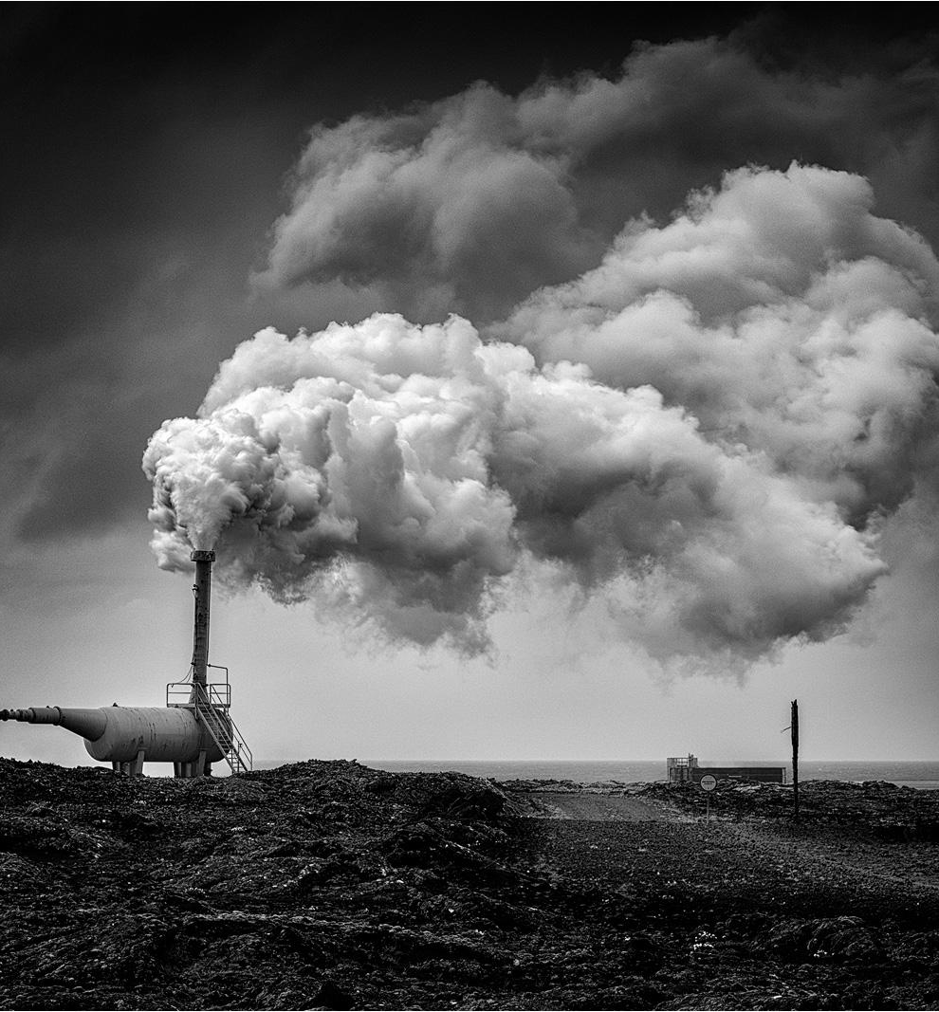
Background
Form Required by the Environmental Protection Agency (EPA)
Tracks facilities that release toxic chemicals which may pose a threat to humans and the environment
Over 700+ chemicals tracked
The Toxic Release Inventory
What is a Carcinogen?
A substance, organism or agent capable of causing cancer

Slide 4
The Dataset
Size
Merging
Shape
Overview
Toxics Release Inventory (TRI) Reporting Form R and Form A Certification Statement for Washington State Facilities from 1994 to 2018.
Cancer Registry from Washington State Department of Health from 1994 to 2018.
18.7 Megabytes
Inner Join on Year & County
124 Attributes
25,799 Rows

Slide 5
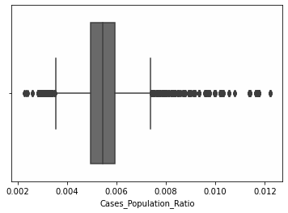
Target Variable
Cancer Rate Flag
If Cases_Population Ratio below Upper Range then…
0 = Cancer Rate Flag
If Cases_Population Ratio above Upper Range (AKA an Extreme Outlier) then….
1 = Cancer Rate Flag

Slide 6
Literature Review
Toxic exposure in America: Estimating fetal and infant health outcomes from 14 years of TRI reporting
Environmental exposomics and lung cancer risk assessment in the Philadelphia metropolitan area using ZIP code–level hazard indices
Focuses on fetal and infant health outcomes from the year 1989 to 2002.
Combined data from various sources to construct a comprehensive set of measures.
The researchers have used a regression model to estimate the effect.
The analysis of the research finds that there is a statistically significant effect on infant mortality rates due to increase in toxic concentrations country wise.
Focuses on lung cancer risk caused by environmental exposure and air pollutants.
The authors considered carcinogens important that are present in the exposure source.
TRI- annual-reporting data for 1987-2017 and NASA satellite data was collected.
Used the modified multi-step multi-criteria decision analysis to investigate the causal effect.
The results showed that there were varying exposures across the 421 ZIP codes under study.

Slide 7
Literature Review
Total and cardiovascular mortality rates in relation to discharges from toxics release inventory sites in the United States
This study looks at the association between different variables covered in the Toxic Release Inventory and the mortality rates among both men and women.
Multiple linear regression models were implemented to assess the impact of these chemicals on mortality rates.
The study’s result showed, there is Statistically Significant association between the four chemical categories and higher mortality rates.

Slide 8
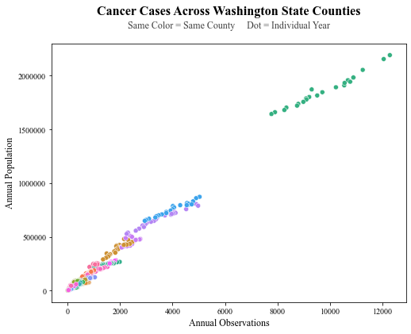
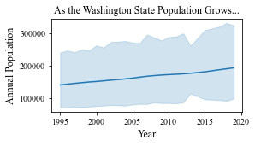
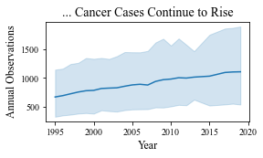
Washington State Cancer Data
King County
Other Counties

Slide 9

Data Pre-Processing
Null value Handling
Data Processing
Nominal Data Processing
Numeric Data Processing
One Hot Encoding
Variable Transformation

Slide 10
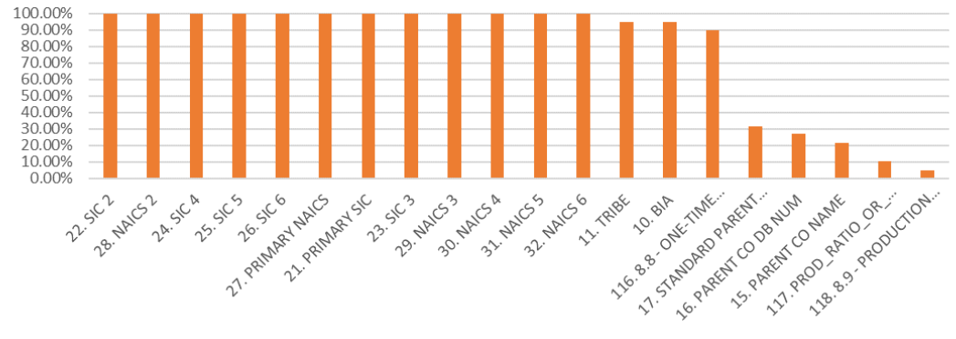
Features w/ the Highest % of Null Values

Slide 11
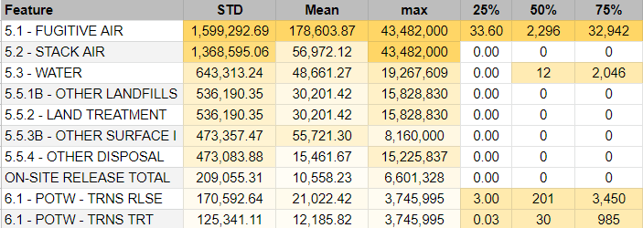
Numerical Data
Descriptive Statistics | Arranged in Order by Standard Deviation
Note: The min. value for all columns is 0. Count is 1036 for all columns with exception of ‘6.2 - M99’ which is 106, and ‘8.8 - ONE-TIME RELEASE’ which is 987.

Slide 12
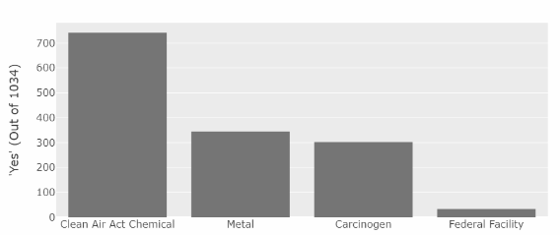
Nominal Data
Five Most Frequent Values for City & Chemical
‘Yes’ Count for Features with only ‘Yes’ or ‘No’ Values
Feature | Category | % of Data
City | TACOMA | 10.35%
 | SEATTLE | 10.06%
 | ANACORTES | 6.96%
 | LONGVIEW | 5.71%
 | SPOKANE | 5.03%
Feature | Category | % of Data
Chemical | Lead | 5.80%
 | Nitrate Compound | 4.74%
 | Lead / Lead Compounds | 3.58%
 | Ammonia | 3.48%
 | Methanol | 3.38%
Note: PFA only had 1 ‘Yes’ and has been excluded from this visualization

Slide 13

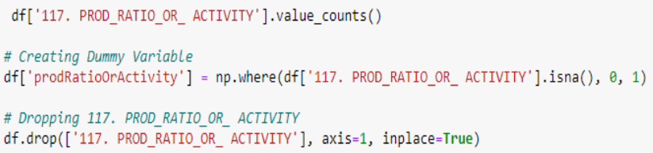
Conversion of nominal data to Numerical values
One Hot Encoding
For ‘117. PROD_RATIO_OR_ACTIVITY’

Slide 14


Correlation Analysis

Slide 15
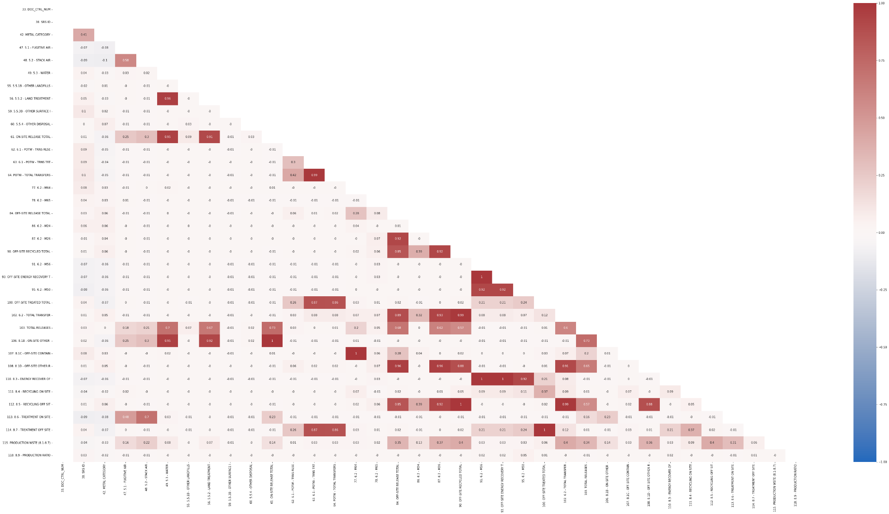
Correlation Analysis

Slide 16
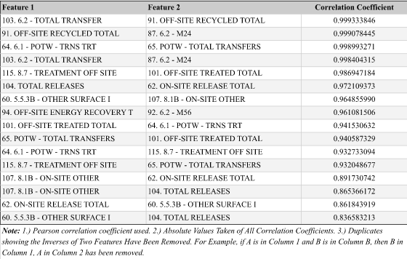
Top 20 highly correlated variables

Slide 17

Synthetic Minority Oversampling Technique (SMOTE)
Then SMOTE was applied…
Target Variable: Is Cancer Predicted?
Recall
More False Positives
Yes
Yes
No
We started with an Imbalanced Dataset…
No
Precision
Less False Negatives

Slide 18
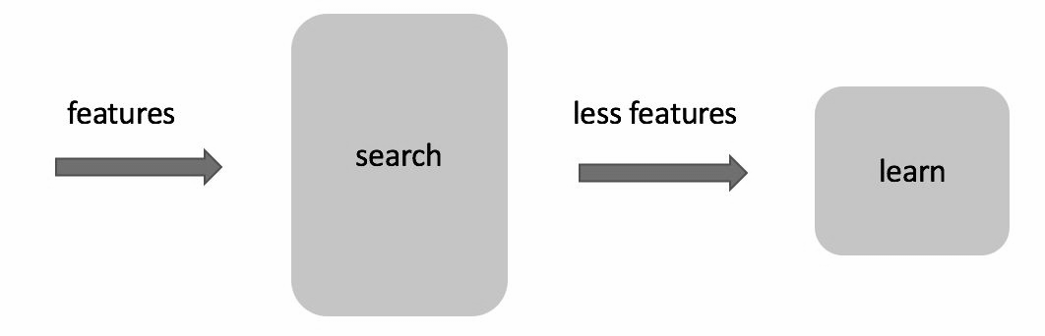
Dimensionality Reduction
Feature Selection

Slide 19
Dimensionality Reduction
Feature Selection using feature importances
We have used feature-importances as the criteria for selecting a subset of features
We have used the random forest classifier as our estimator
Total 122 features were selected by this method

Slide 20
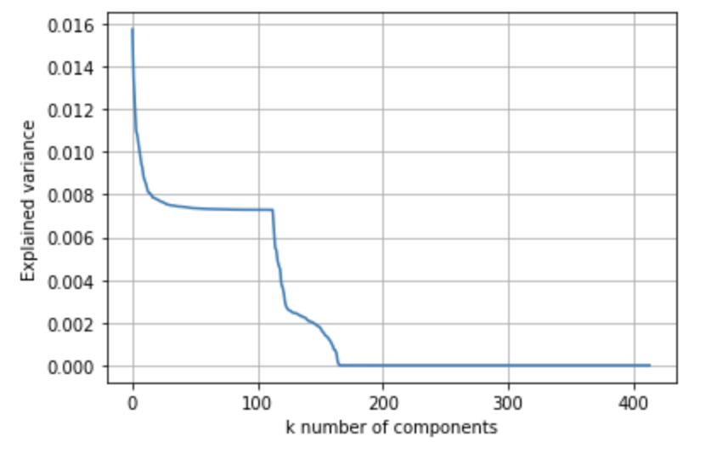
Dimensionality Reduction
Principal Component Analysis (PCA)
PCA Analysis
Some features highly correlated
Transform the original data into reduced number of linear combinations of the original features
Determine how many transformed features (or primary components) we want to use in our model.
PCA provided an array of variances of each component in descending order
We have inspected the variances by a scree plot
PCA value 130 works good for analyzing this dataset.

Slide 21
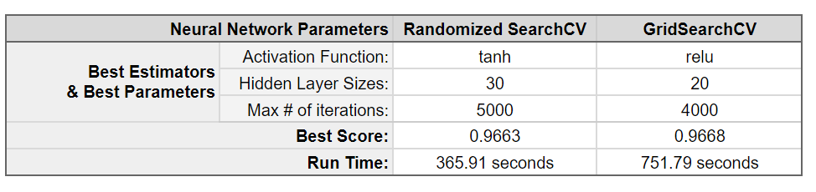
Hyper Parameter Tuning

Slide 22
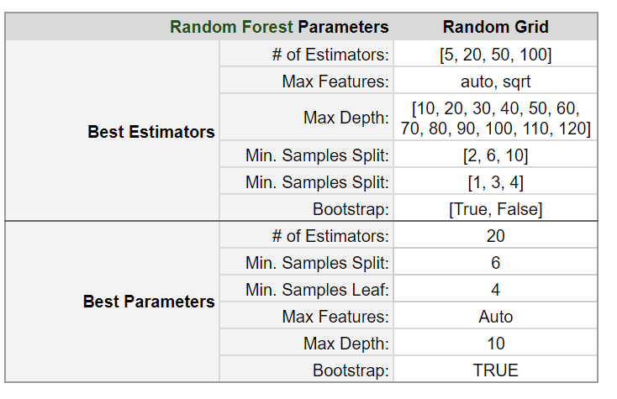
Hyper Parameter Tuning

Slide 23
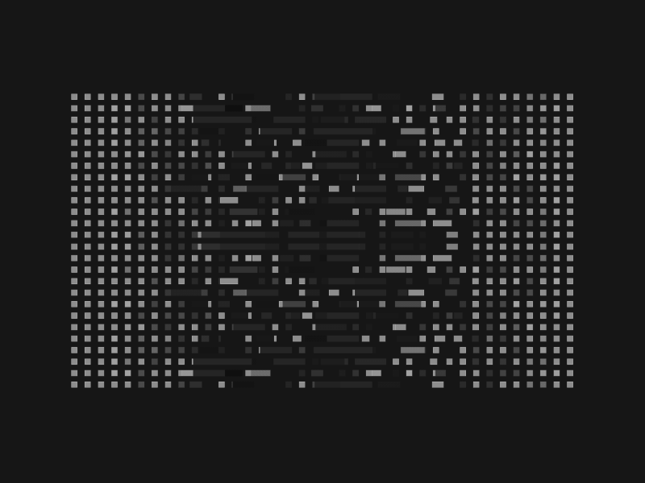
Applying machine learning algorithms
Decision Tree
Random Forest
Gradient Boosting
Naive Bayesian Classification
Neural network -
GridSearchCV
RandomizedSearchCV

Slide 24
Random Forest
Random Forest Classification | Original Dataset | SMOTE applied Dataset | Feature selected Dataset | PCA applied Dataset
Accuracy | 0.92 | 0.97 | 0.93 | 0.89
Precision | 0.76 | 0.96 | 0.80 | 0.47
Recall | 0.41 | 0.98 | 0.42 | 0.21
Mean score after applying K-Fold | 0.90 | 0.97 | 0.90 | 0.88

Slide 25
Gradient Boosting
Gradient Boosting Classification | Original Dataset | SMOTE applied Dataset | Feature selected Dataset | PCA applied Dataset
Accuracy | 0.97 | 0.98 | 0.97 | 0.90
Precision | 0.97 | 0.98 | 0.95 | 0.94
Recall | 0.95 | 0.98 | 0.97 | 0.73
Mean score after applying K-Fold | 0.9863 | 0.9782 | 0.9848 | 0.8906

Slide 26
Neural Network with GridSearchCV
Neural Network | Original Dataset | SMOTE applied Dataset | Feature selected Dataset | PCA applied Dataset
Accuracy | 0.87 | 0.87 | 0.89 | 0.88
Precision | 0.35 | 0.84 | 0.42 | 0.36
Recall | 0.24 | 0.91 | 0.23 | 0.18
Mean score after applying K-Fold | 0.88 | 0.92 | 0.88 | 0.89

Slide 27
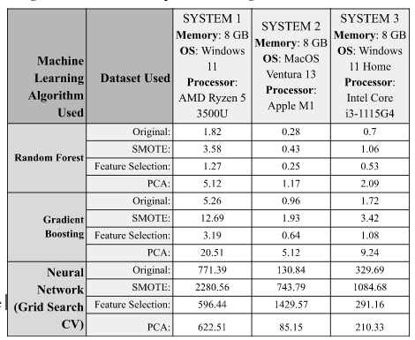
Computation Time Comparisons
Note: Times are in seconds

Slide 28
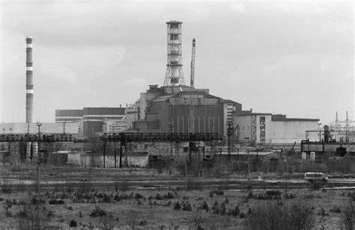
Domain Knowledge
All about Cancer
Merging of Data
Controlling Variables
Creating Metrics

Slide 29
Methodological Contribution
Merging the dataset
Nominal and numerical data
Data preprocessing
Null value processing
Nominal data processing
One hot encoding
Variable transformations
Synthetic Minority Oversampling Technique (SMOTE)
Feature selection
Primary component analysis (PCA)

Slide 30
Limitations
Cancer = Hard to Study
Timeline of Exposure to Carcinogens leading to Cancer can take Months/Years/Decades
¼ Trillion Dollar Industry Much of Which is Focused on Research
Missing Features That Are Also Correlated with Increased Rates of Cancer
Control for Average Age in a County, Smoking Rate in a County
Accounting for…
Previous Year’s Factory Output
Other Factories/TRI Reports in the Same County
Imprecise Distance Metric
Lack of Subject Matter Expertise

Slide 31
Future Projects
Implement Missing Features
Accounting for Other TRI Reports/Factories in the Same County
Accounting for Zoning/Distance through Improved Location Metric
longitude and latitude of a factory’s location to the most densely populated residential point in county
Increasing the training data by data augmentation

Slide 32
Thank You!

